Slide 1
KERALA STATE REPORT

Slide 2
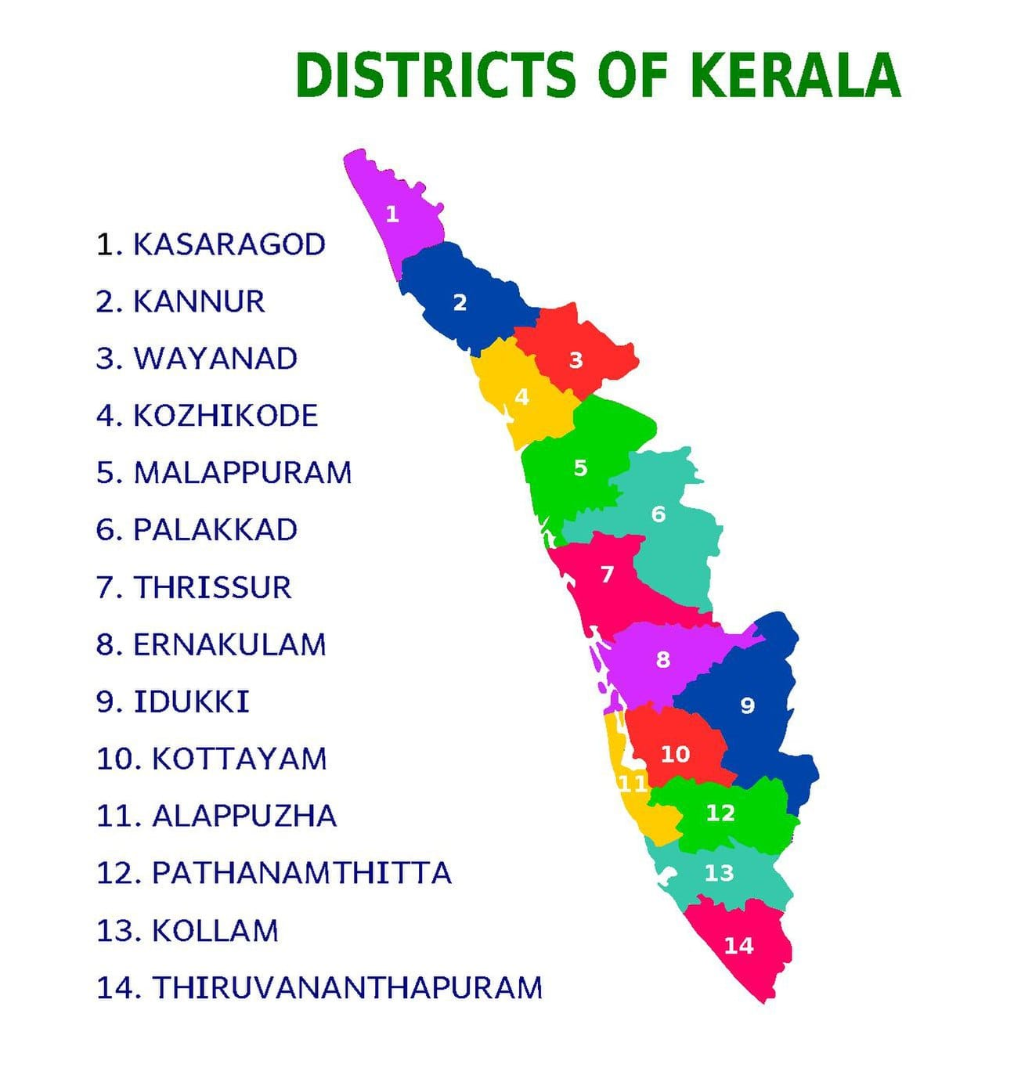

Slide 3
SMP’S OF KERALA

Slide 4
NORTH ZONE
KASARGOD – SOL:JITHIN JOSEPH
KANNUR -SOL: PHILOMINA
VADAKARA – SOL: TREASA PETER
WAYANAD – SOL: VIVEK KUMAR
KOZHIKODE –SOL: KOSHY P.M
PONNANI – SOL: SHANTAMMA KOSHY
MALAPPURAM – SOL: PRAISON THOMAS
PALAKKAD –SOL: SUMA KURIAKOSE

Slide 5
CENTRAL ZONE
ALATHUR – SOL: JESMI SUNIL
THRISSUR – SOL: SUNIL
CHALAKUDY – -SOL: ROSEY MATHEW
ERANAKULAM –SOL: USHA SONNY
IDUKKI –SOL: GLADSON MATHEW
KOTTAYAM –SOL: MARIAMMA ALEX

Slide 6
SOUTH ZONE
ALAPUZHA – SOL: EUGIN
MAVELIKARA – SOL: REHANA CHACKO
KOLLAM – SOL: NIRMALA LAZER
ATTINGAL – SOL : SHYAJA SATHEESAN
TRIVANDREUM – SOL: SABEENA CLEETUS

Slide 7
NEW CORE TEAM MEMBERS
SPEAKER : SOL: SHYLAJA SATHEESHAN
DEP. SPEAKER : SOL: KOSHY P.M
SECRETARY : SOL : SAJITHA EUGIN
GIFT SCHOOL CO-ORDINATOR : SOL: SINDHU RAJU
GIFT SCHOOL SECRETARY :SOL: TRESA PETER

Slide 8
STATE COORDINATORS LIST
JULY TO DEC 2024
TROOP CHURCH ,TROOP SCHOOL – SOL: ANNIE PONNAN
BFF – SOL: KOSHY P.M
DAVID SCHOOL OF WORSHIP - SOL : MARIAMMA ALEX
MONTHELY WORSHIP – SOL : SABEENA
DELIVERANCE LEVEN 1 – SOL : SAJITH EUGIN
DELIVERANCE LEVEL 2 – SOL: SINDHU RAJU
DELIVERANCE LEVEL 3 – SOL: TRESSA PETER
HEALING LEVEL 1 – SOL : EUGIN VINCENT
HEALING LEVEL 2 – SOL : GEETHA GOPINATH
PROPHCY LEVEL 1 – SOL : SUMA KURIAKOSE
PROPHECY LEVEL 2 – SOL : SUNIL
FAMILY BUILDING – SOL: ROSEY MATHEW
HOSPITALITY – SOL : NIRMALA LAZER

Slide 9
NEHEMIAH SCHOOL OF ADMINISTRATION – SOL: GLADSON MATHEW
FINANCIAL DISCIPLINE – SOL: PHILOMINA
FUNERAL SERVICE – SOL: FERNANDEEZ
MATRIMONY –SOL: KOSHY P.M
TRANSALATORS – SOL: NIRMALA AND SOL: USHA
CBS – SOL: BETTY MATHEW
DANIEL ACCADAMY – SOL: GIRIJA

Slide 10
MORNING WORSHIP
NORTH ZONE
CENTRAL ZONE
SOUTH ZONE – ALLAPUZHA,KOLLAM
ATTINGAL,MAVELIKARA
PATHANAMTHITTA

Slide 11
FASTING PARAYER
Fasting prayer is conducted in pathanmthitta district on every month
Fasting prayer is conducted in North zone every month

Slide 12
NIGHT PRAYER
NIGHT PRAYES IS CONDUCTING ON ATTINGAL MAVELIKKARA IN EVERY MONTH

Slide 13
24 HOURS ONLINE WORSHIP
ATTINGAL MAVELIKKARA CONSTITANCE TOGETHER CONDUCT ONLINE WORSHIP IN EVERY MONTH

Slide 14
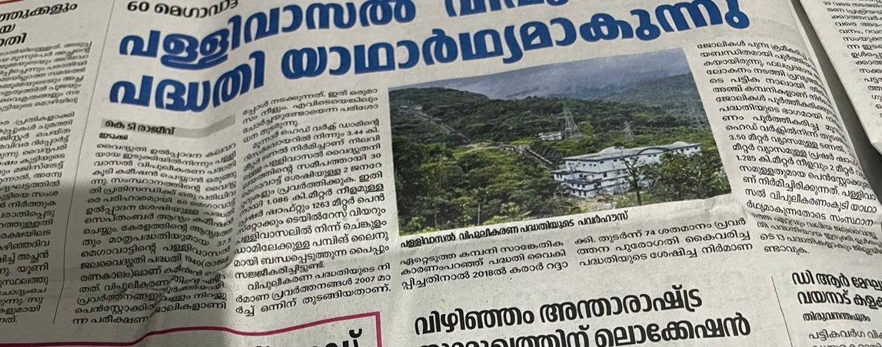
HYDRO ELECTRIC POWER STATION IDUKI

Slide 15
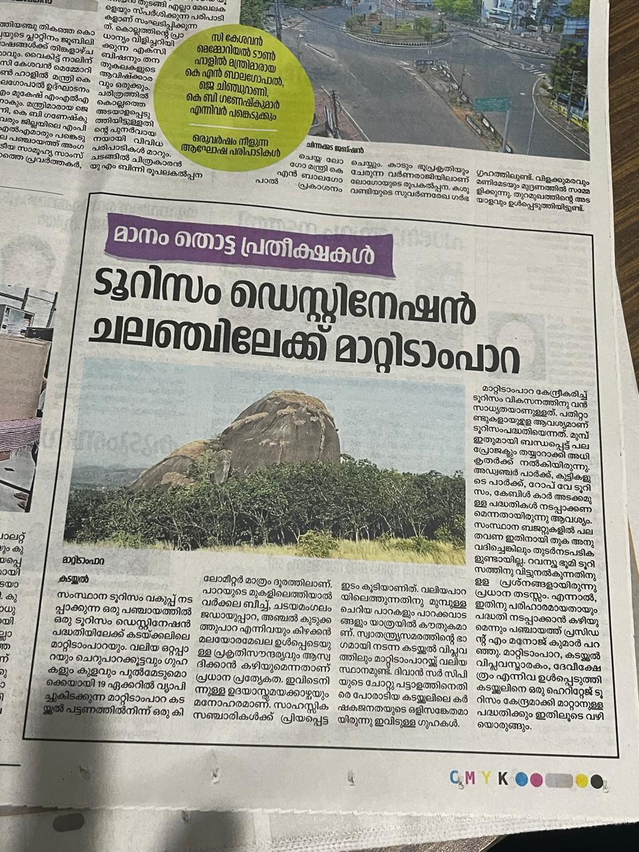
NEW TOURIST PROJECT ON KADACAL KOLLAM – MARTIAN PARA

Slide 16
GIFT SCHOOLS
JERMIAH SCHOOL OF PEROPHECY WAS CONDUCTED ON 13-06-2024
FRP LEVEL 2 WAS CONDUCTED ON 17-6-2024

Slide 17
PLANNING
WORSHIP SCHOOL
FAMILY BUILDING
FRP LEVEL 1
ATTINGAL,MAVELIKKARA & KOLLAM IS GOING TO CONDUCT FELLOWSHIP MEETIG

Slide 18
Troop chruch
North zone conduct a new troop church named ebenezer . Six new members have attent here

Slide 19
GLORIFY IN THE NAME OF GOD

